Slide 1

SARANSH

Slide 2
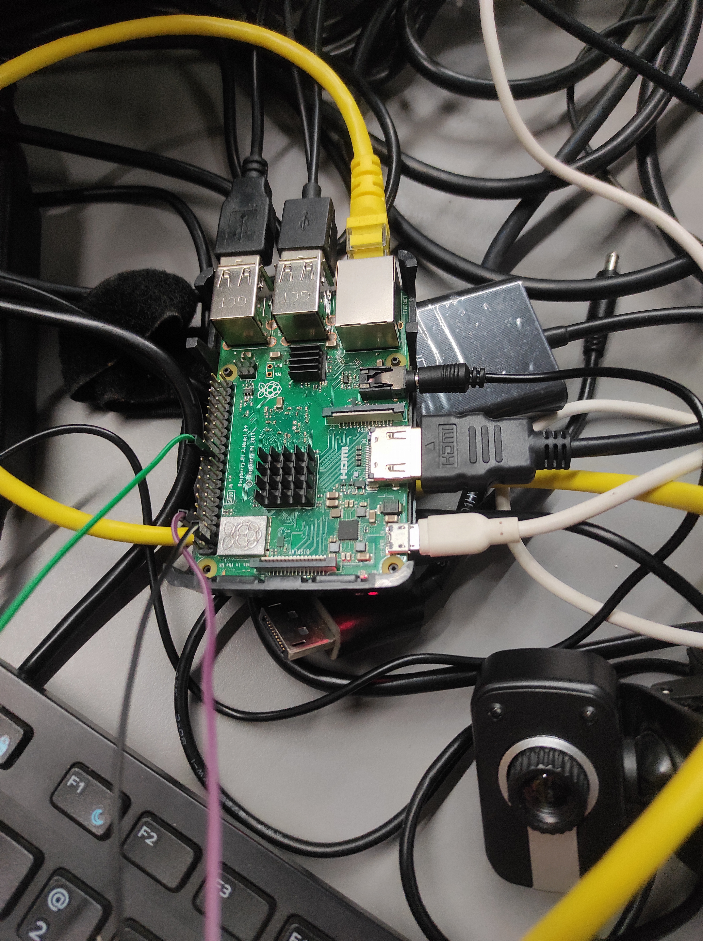
What is SARANSH?
SARANSH, derived from the Sanskrit language means Summary. Basically it is a hardware and software-based project.
There are so many peoples who don’t have eyesight, and they face various types of problems in their daily routine life like a reading problems, so we design a system name SARANSH.
SARANSH For those who want to read books/novels/newspapers but they haven’t time in there day to day life.

Slide 3
TOOLS AND TECHNOLOGY
RASPBERRY PI
TACTILE SWITCH
PYTHON3
BREAD BOARD
PYTTSX3
Pillow - PIL
WEB-CAM
HUGGING FACE TRANSFORMER
SPEAKER
TESSERACT-OCR ENGINE

Slide 4
HOW IT WORKS?
By push-pull button, we capture a frame with the help of a webcam.
After capturing that frame our model collects the text from it and with the help of the PYTESSERACT library, it will convert image files into text.
The model creates a summary of the extracted text and by using PYTTSX3, it converts the summary into speech.
At last, we transfer our whole PYTHON file into RASPBERRY PI. After processing all the files, we got a summary of that text in our needful language.

Slide 5
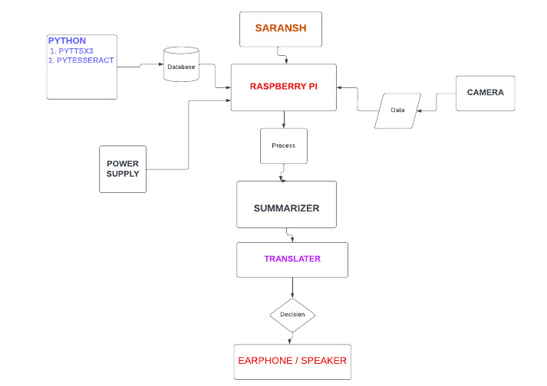
FLOWCHART

Slide 6
USE CASE AREA
News article or blog summarization to quickly grasp the main points.
Summarizing lengthy research papers or reports for easier digestion.
Summarizing legal documents for faster understanding of key points.
Summarizing customer feedback for quick analysis
Last minute exam preparation

Slide 7

CONCLUSION
Our goal is to create a system that could accurately and reliably summarize long documents into shorter, more manageable pieces of information.

Slide 8
THANK YOU!

